Slide 1


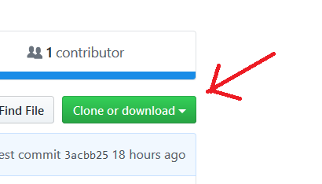

Introduction to R and RStudio a Please download course materials at: https://github.com/nhs-r-community/intro_r
Name 1 | Name 2
Name 1 @nhs.net | Name 2 @nhs.net
Healthcare Analysts | Organisation

Slide 2
1-2-4-
(Name)
What would be a good result today?
3:00

Slide 3
About the trainers
What do you do?

Slide 4
Assumptions about you
What is the nature of your work?
Reporting? Project based? Data reconciliation? Statistics? Collaboration?
Tools – Excel, SQL, Power BI? Tableau?
Answers – Reports? Presentations?
Will shape what you want from today.

Slide 5
Agenda
“Adjusting the seat and mirrors”:
Intro + Setup + Import data
Graphics with ggplot2
Data wrangling with dplyr
--------- Lunch -----------
Naming objects | Joins
R Markdown
Break 15 mins
Demo

Slide 6
Course Aims
To show you some of the possibilities:

Slide 7
elegant Graphics

Slide 8
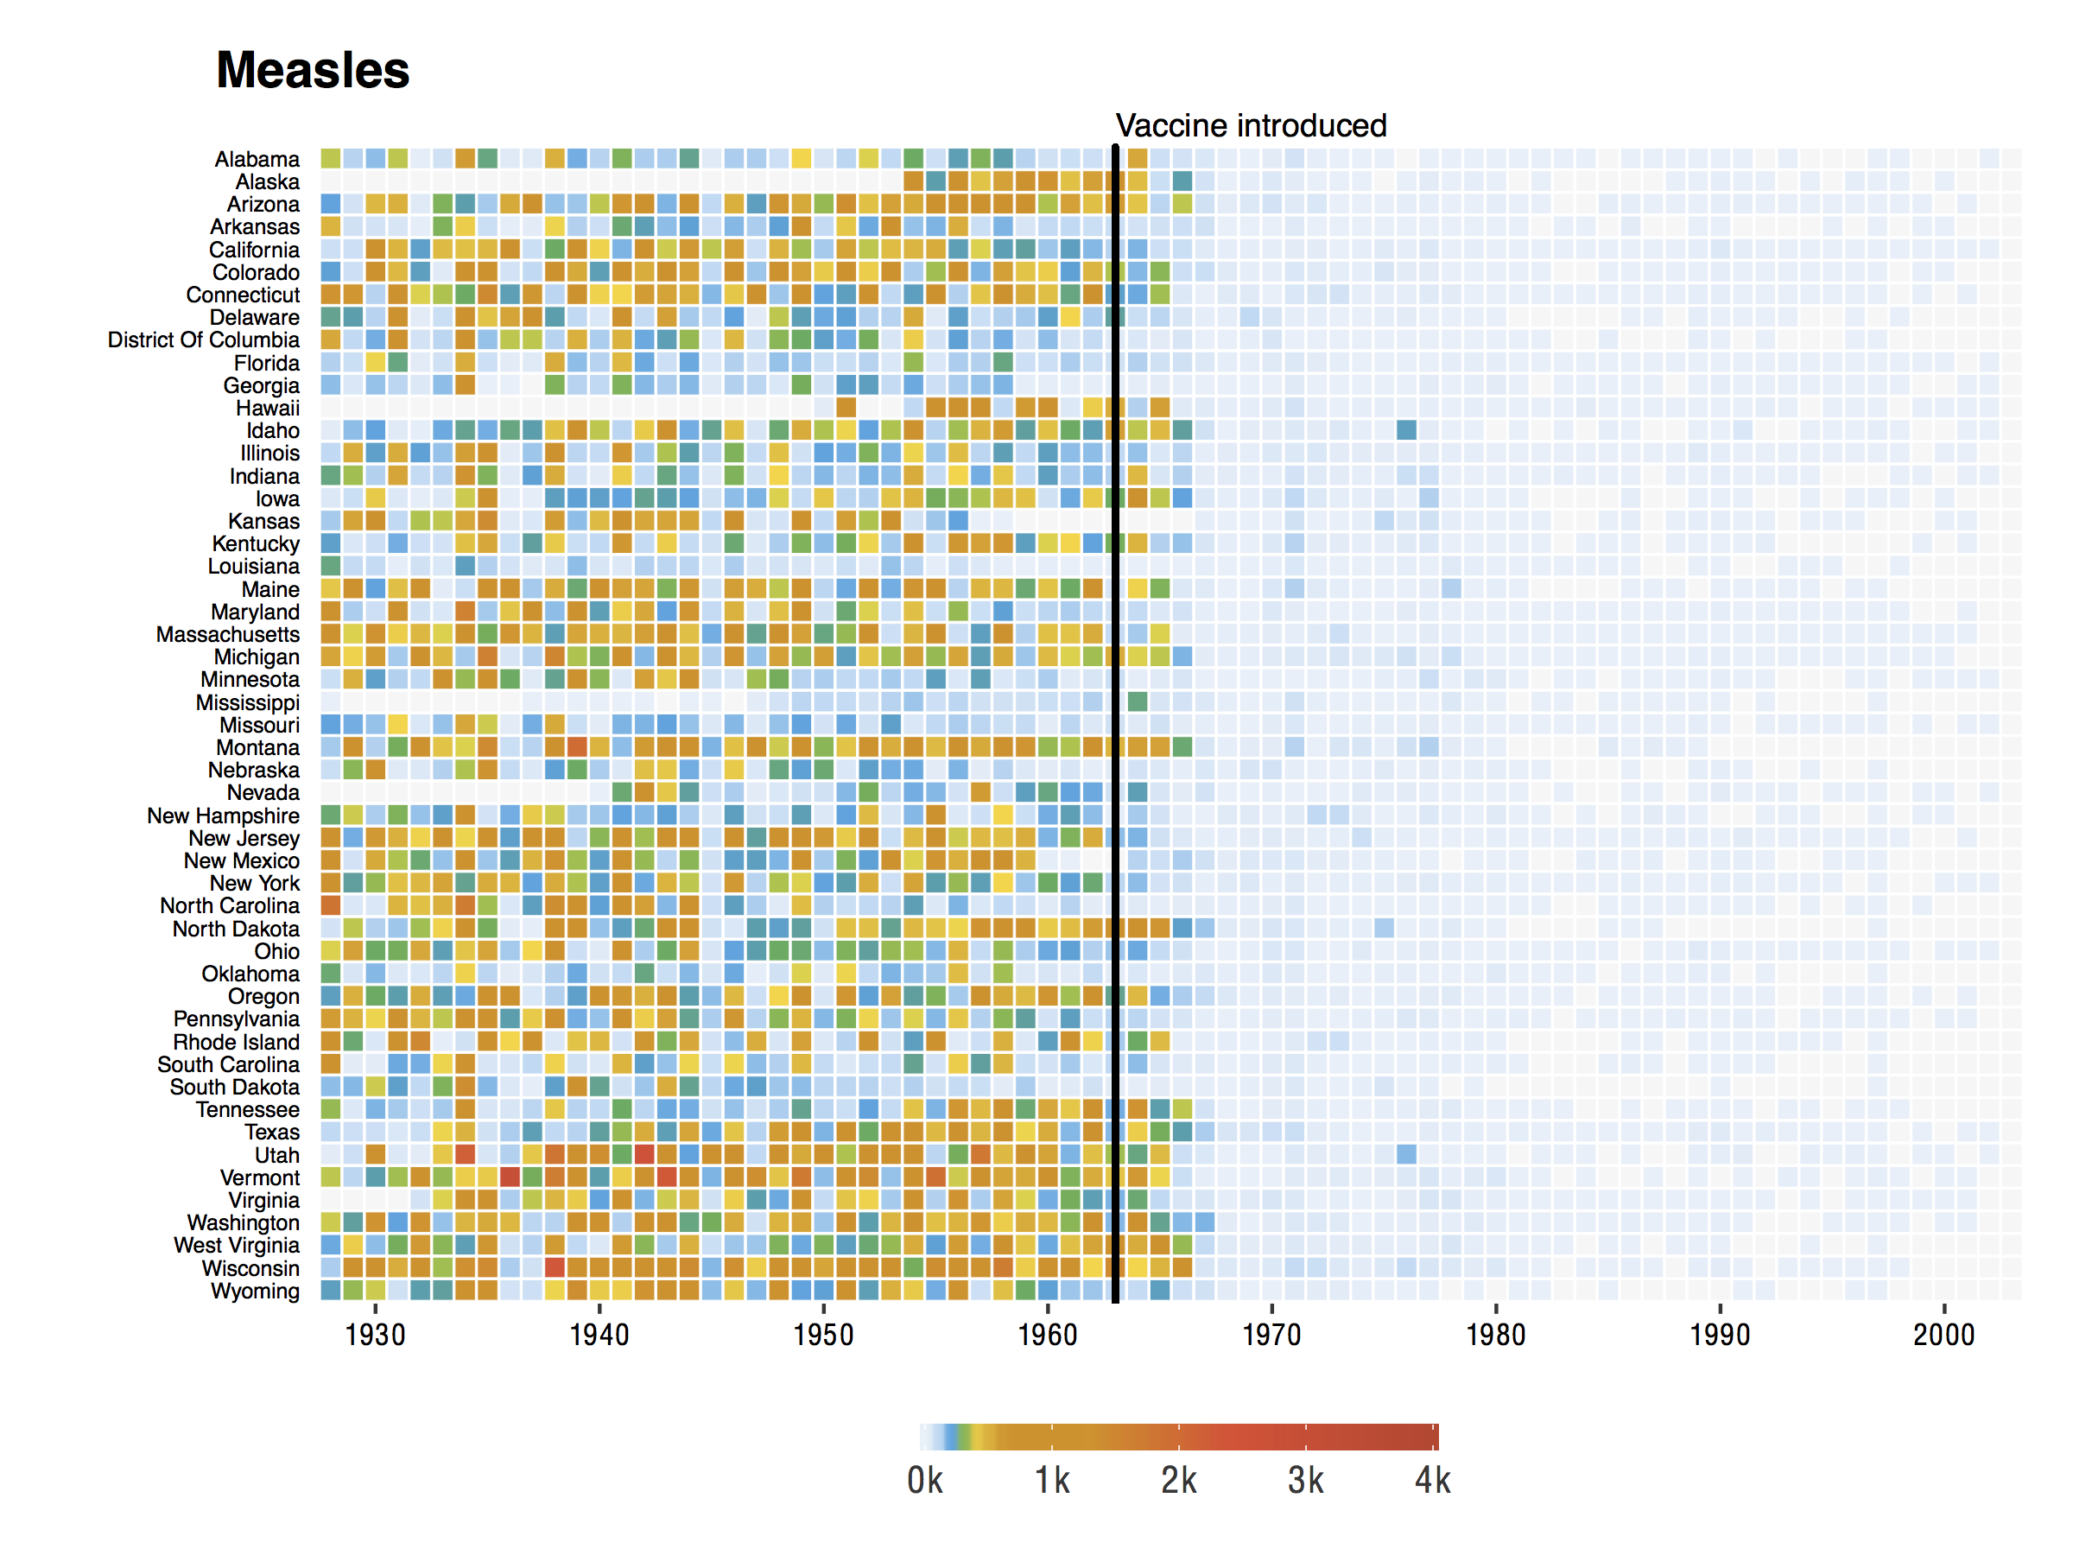
https://benjaminlmoore.wordpress.com/tag/ggplot2/

Slide 9
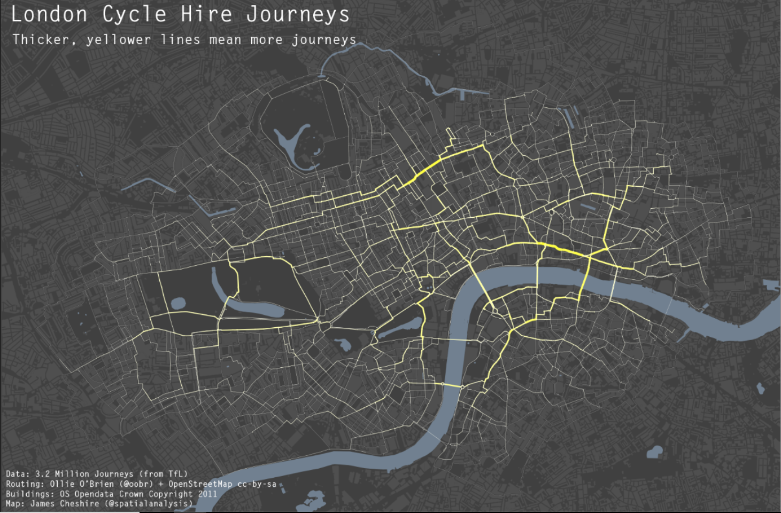
http://spatial.ly/2012/02/great-maps-ggplot2/

Slide 10
Statistics & Machine Learning ( example later )

Slide 11
Collaboration & Reproducibility

Slide 12
R Markdown

Slide 13
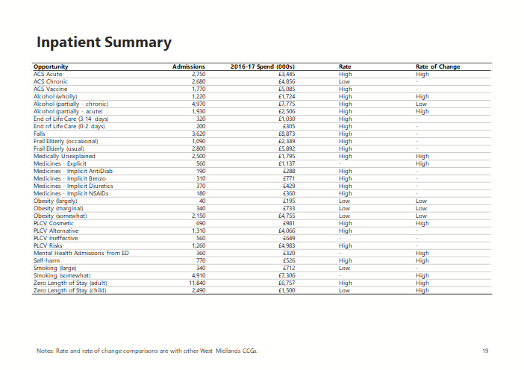
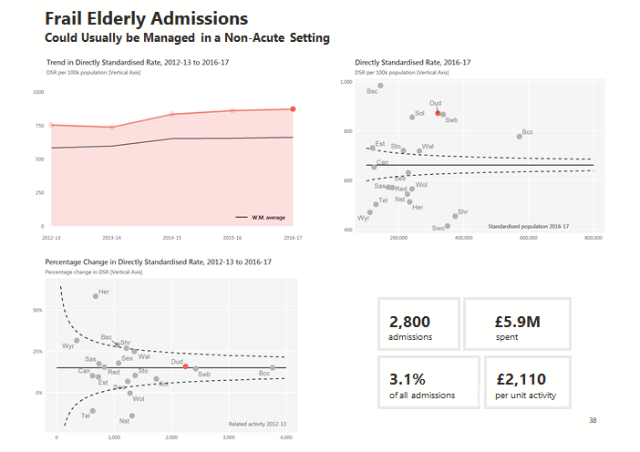
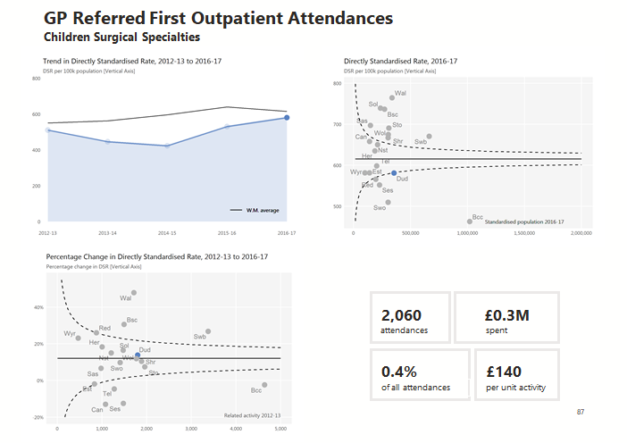
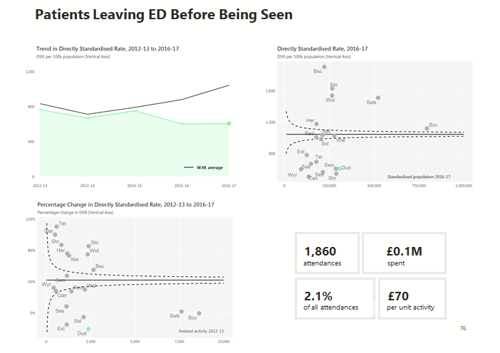
Automated reports
1800 unique graphics
100 unique tables
built into a
PowerPoint
from R

Slide 14
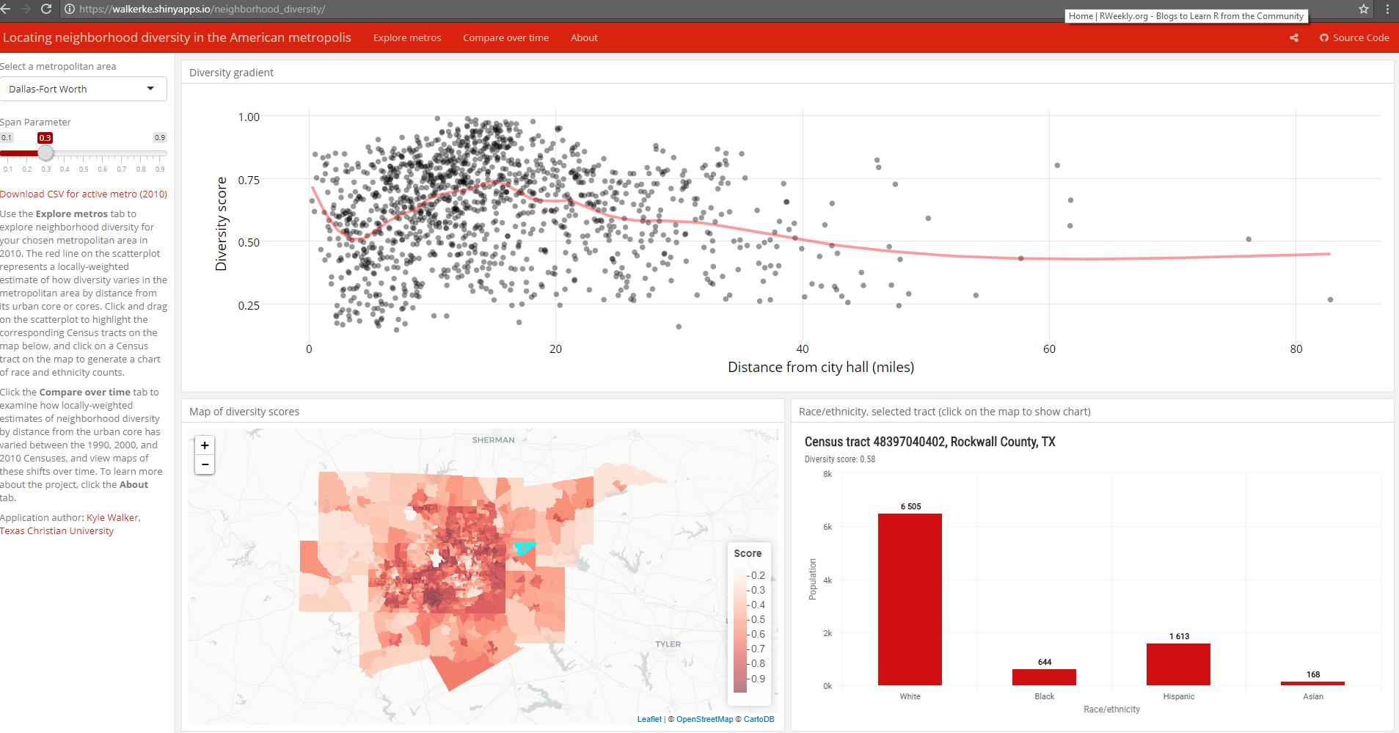
(Interactive) Dashboards
https://walkerke.shinyapps.io/neighborhood_diversity/

Slide 15
R to SQL connection

Slide 16
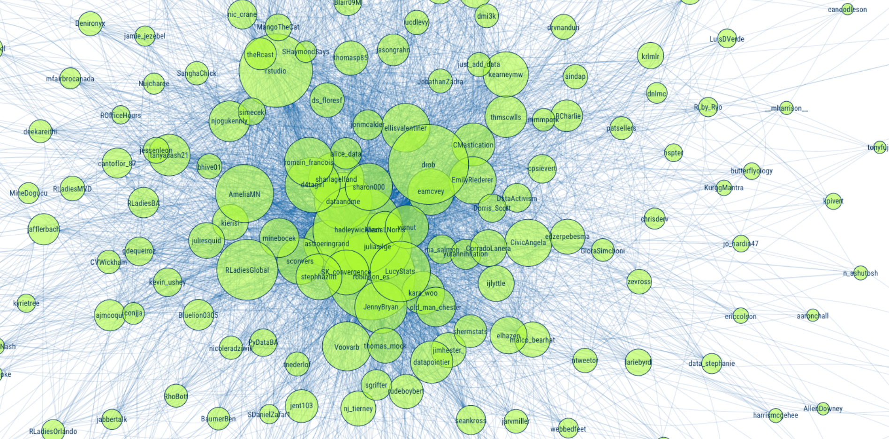
Community
https://github.com/mkearney/rstudioconf_tweets

Slide 17

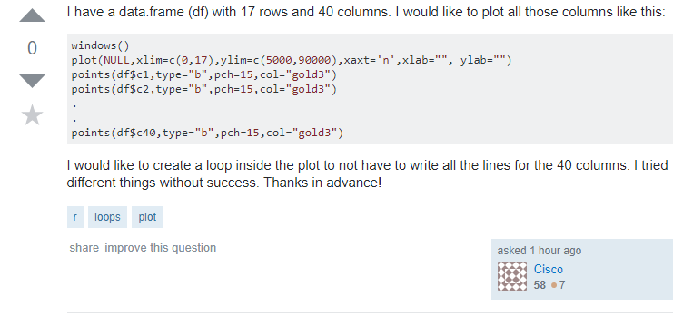
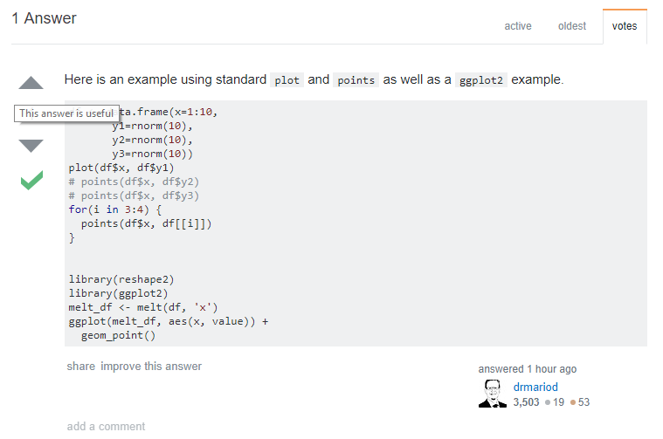

Slide 18

Inclusivity

Slide 20
Course Aims
To show you some of the possibilities.
To give you a feel for how R works.

Slide 21
Course Aims
To show you some of the possibilities.
To give you a feel for how R works.
To show you enough for you to begin teaching yourself
(Excellent free resources available)

Slide 22
Course philosophy

Slide 23
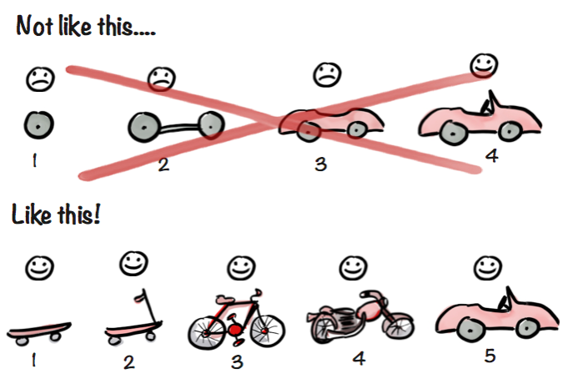
MVP Diagram
https://blog.crisp.se/2016/01/25/henrikkniberg/making-sense-of-mvp
Henrik Kniberg

Slide 24
Course philosophy
Relaxed and informal.
(Slides and code are available online)
The truth; but it can’t be the whole truth…
too much to cover in a day).

Slide 25
Let’s begin…

Slide 26
R vs. RStudio
R is a programming language
RStudio is a software application with tools to improve your programming experience

Slide 27
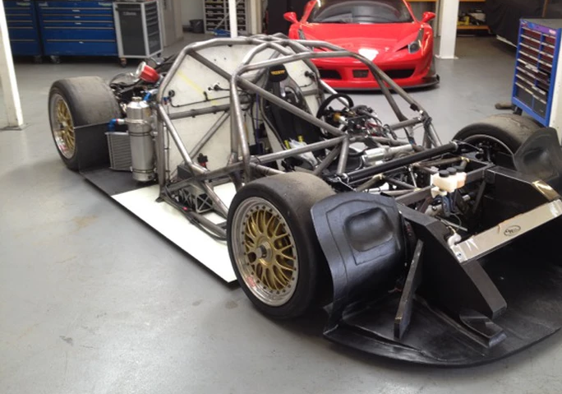
R
Credit: http://www.rollcentre.com/project--onuk-sazan-

Slide 28
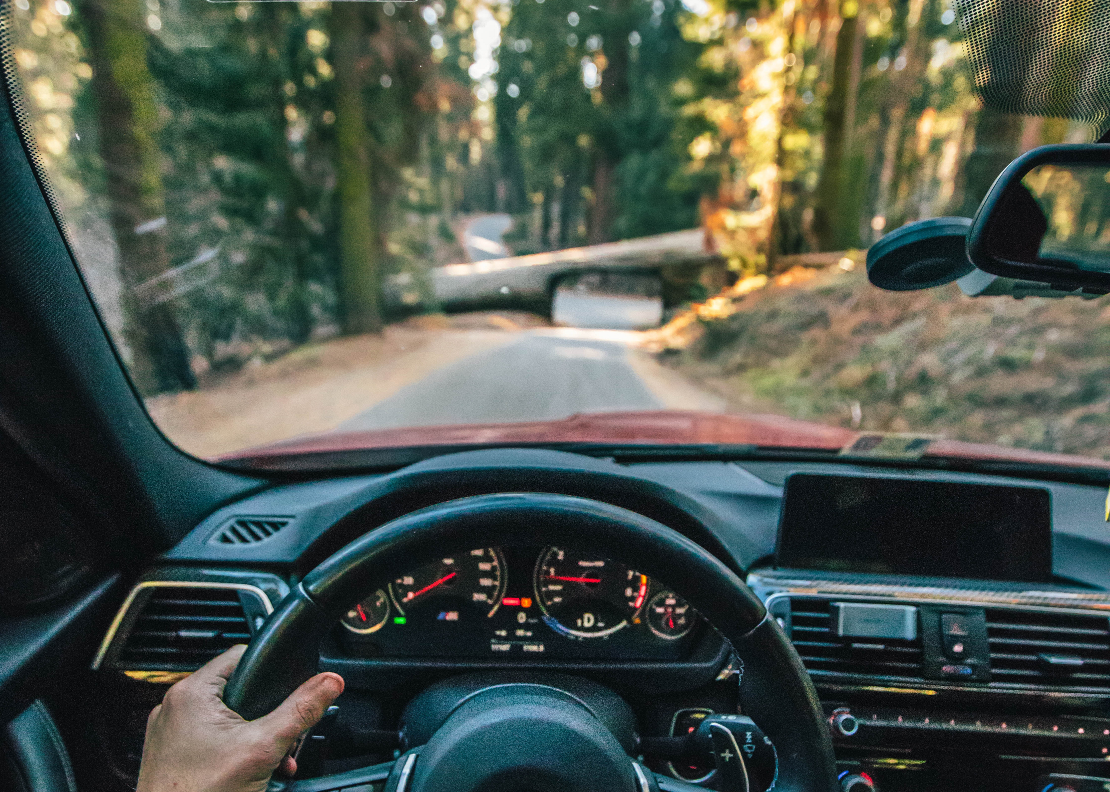
RStudio
Photo by Roberto Nickson (@g) on Unsplash

Slide 29
RStudio
Many excellent features to help you with your analyses.
Never again have to think about R and RStudio as separate: Opening R-Studio opens an R session.
Analogy from the book Modern Dive: www.moderndive.com

Slide 30
Open RStudio
Opening R-Studio opens an R session.

Slide 31
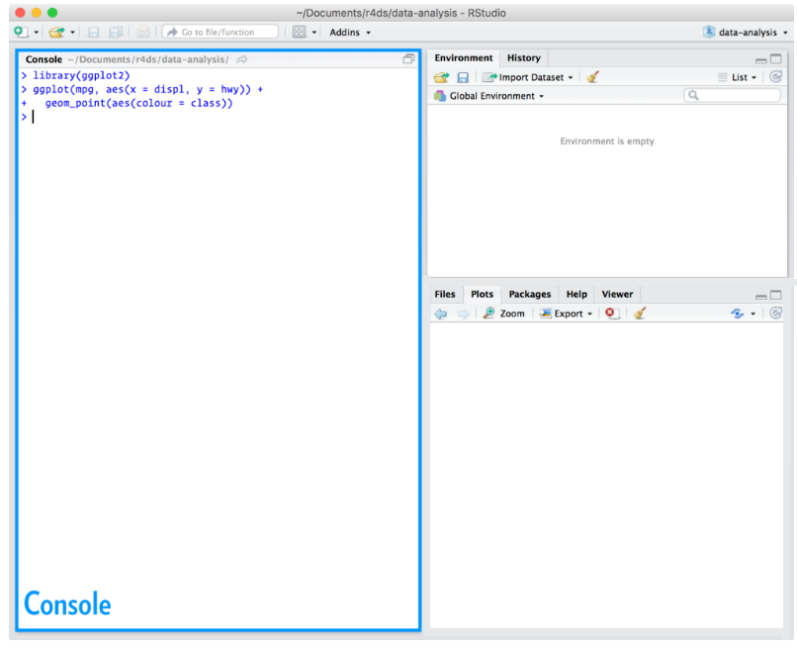
The Console is your window to R.
You can code directly in the console…
pi*2 [Enter]
37/12 [Enter]
… but there is a better way…

Slide 32
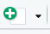
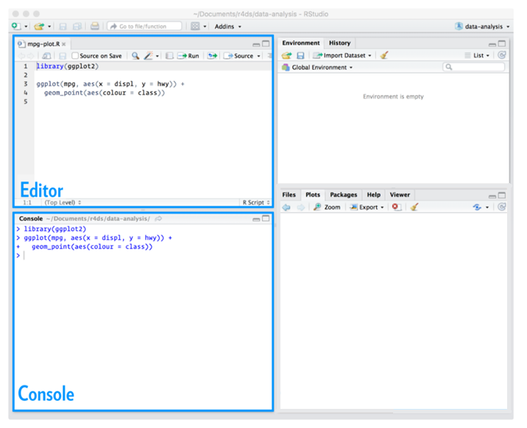
The Editor.
If you don’t see the Editor
pane, click:
And choose
“R Script” from the drop-down.
Or, shortcut:
Ctrl+ Shift+ N

Slide 33
The Editor is just like any other text editor: you can copy, paste, and save text.
More forgiving
R Syntax highlighting
Autocomplete
(use it!)
Ctrl + Enter (sends line of code to Console)

Slide 34
Comment code with a #
E.g:
# this was a bad idea
Notes:
Also note
8 Object “character string”

Slide 35
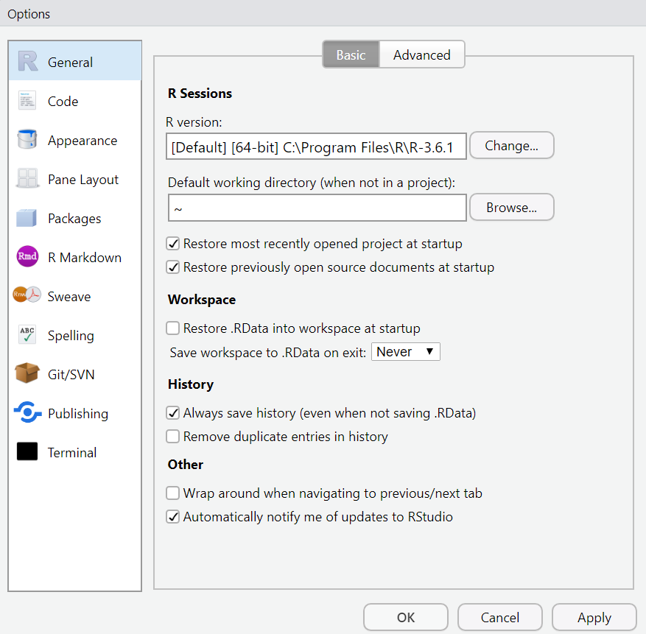
Tools → Global Options

Slide 36
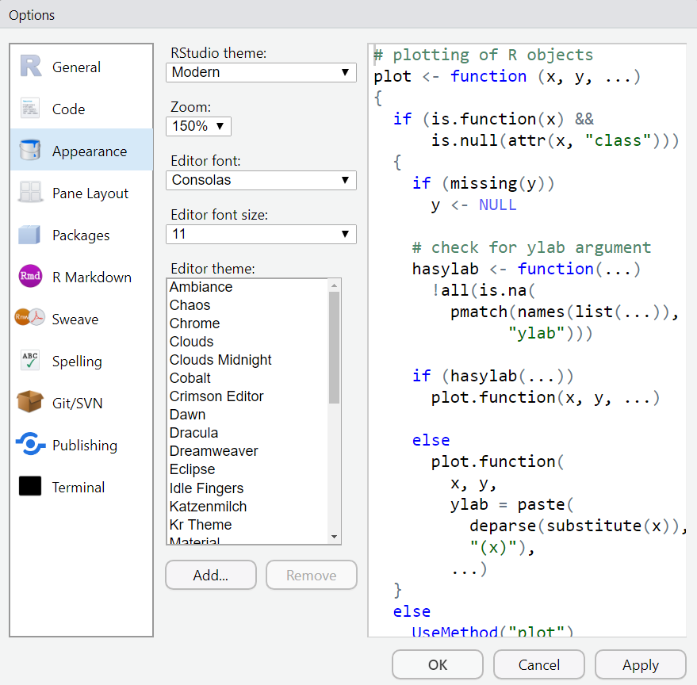
Tools → Global Options

Slide 37
Packages

Slide 38
Packages
R packages are like apps for your phone:
Extend the capabilities of the basic or “base" R
with extra functions, datasets, documentation.

Slide 39


Packages
Download App
Download
(install.packages)
Phone detail from photo by Rahul Chakraborty on Unsplash
Happens
just once
Open
the App
“Open”
library()
Every new session

Slide 40
Packages
install.packages(“tidyverse”)
library(tidyverse)
will download a package to your personal library. Then:
tells R to load the tidyverse package from your personal library.
(Needed for every new session)

Slide 41
CRAN repository
14,000+ packages. Free. Peer reviewed.
(Manifold possibilities) eg. interactive graphics and dashboards, machine learning, mine twitter data, create PowerPoint docs, maps…
Other ways to get packages (eg. GitHub, …)

Slide 42
Packages: tidyverse

Slide 43
What is the tidyverse?
The tidyverse package collects (some of) the most popular R packages into one.
All have the same underlying principles:
Provide simple tools (with consistent structure) which may be used together to help solve complex problems.

Slide 44
What is the tidyverse?
During the workshop we will use the ggplot2, dplyr, and readr packages. These are bundled up in the tidyverse package. We load it by running:
library(tidyverse)

Slide 45
This material was created for the NHS-R community by:
Andrew Jones @The Strategy Unit
The work is licenced under:
Creative Commons
Attribution-ShareAlike 4.0
International
To view a copy of this license, visit
https://creativecommons.org/licenses/by-sa/4.0/

Slide 46
End

